Slide 1


P6 – Demo Presentation
Wesley Baker, William Hao, Kierstin Hicks,
Dipen Patel, Srijan Srivatsa, Richard Young
Notes:
Hello Everyone. This is the Spring 2026 Food Consortium’s P4 Mini Presentation.

Slide 2
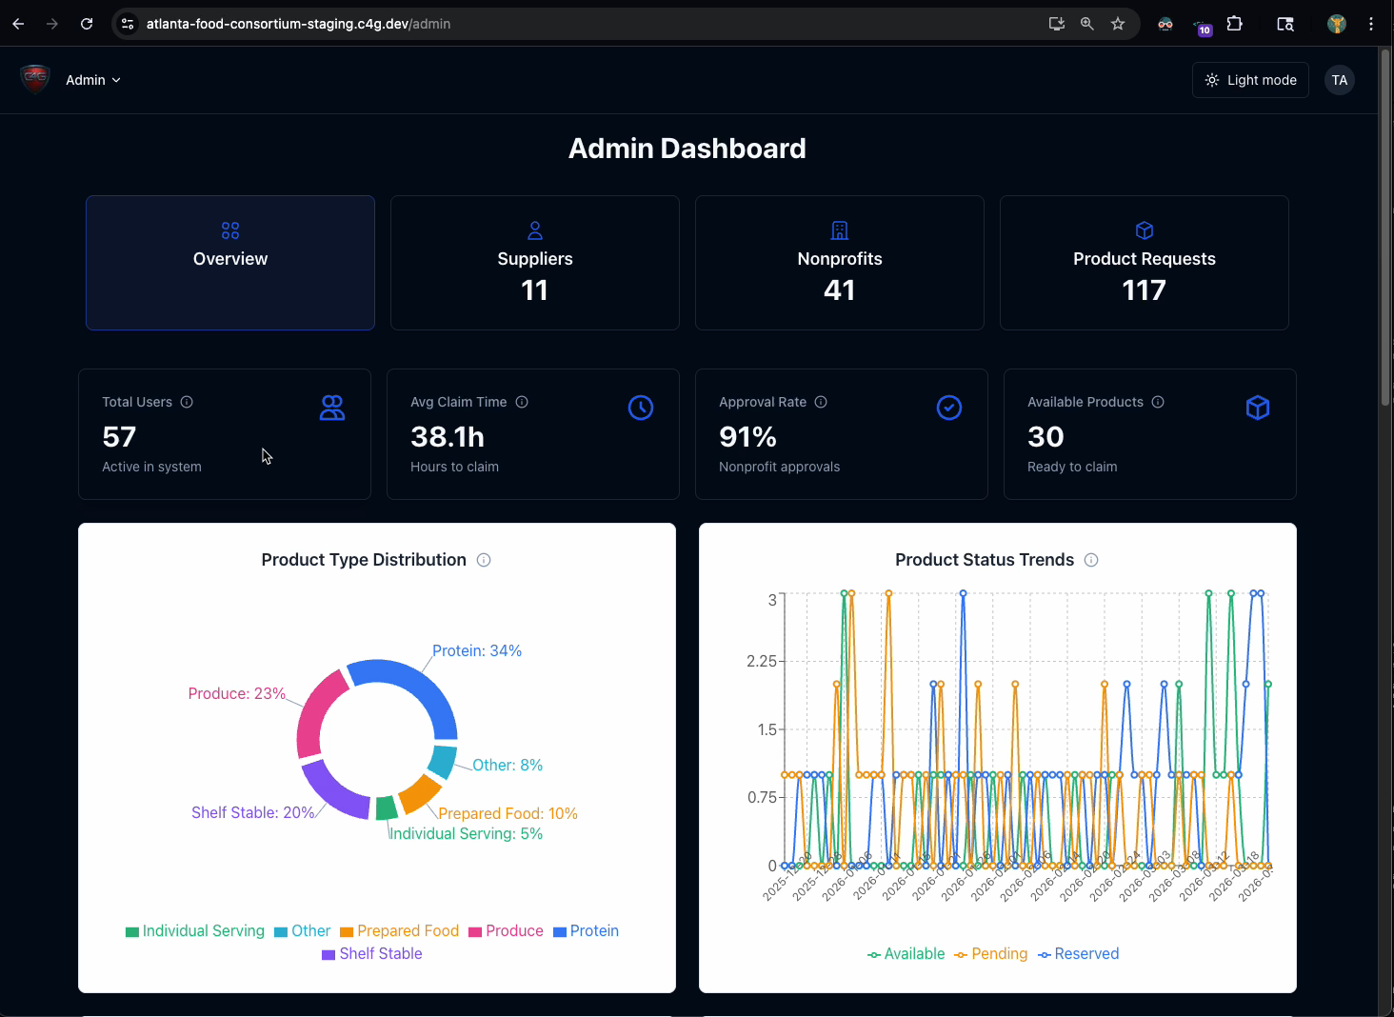
Demo Video – Admin Role

Slide 3
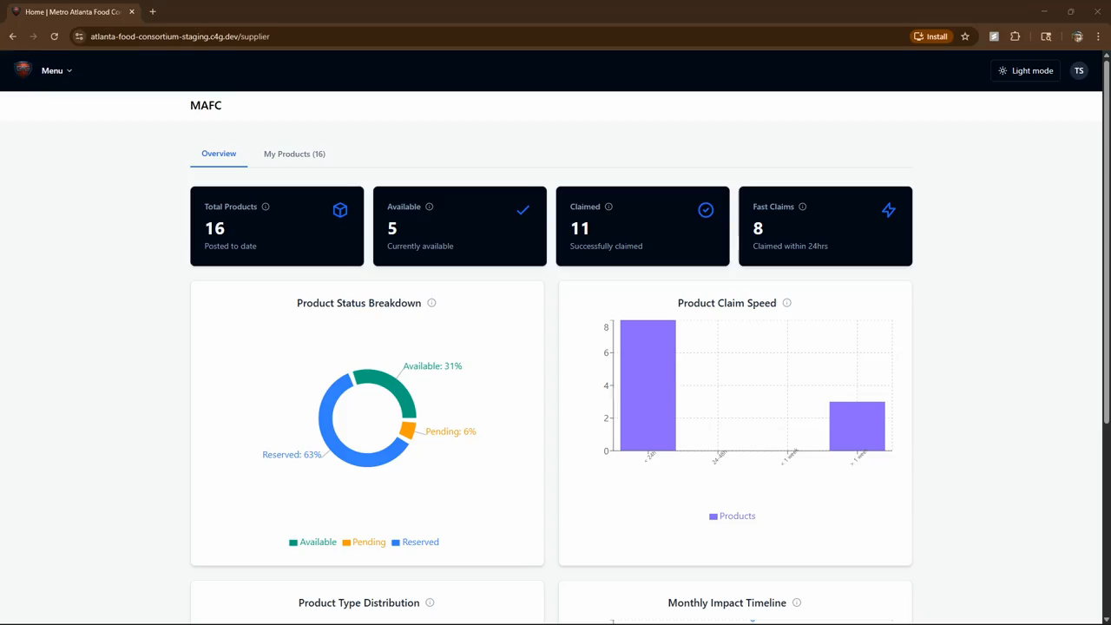
Demo Video – Supplier Role

Slide 4
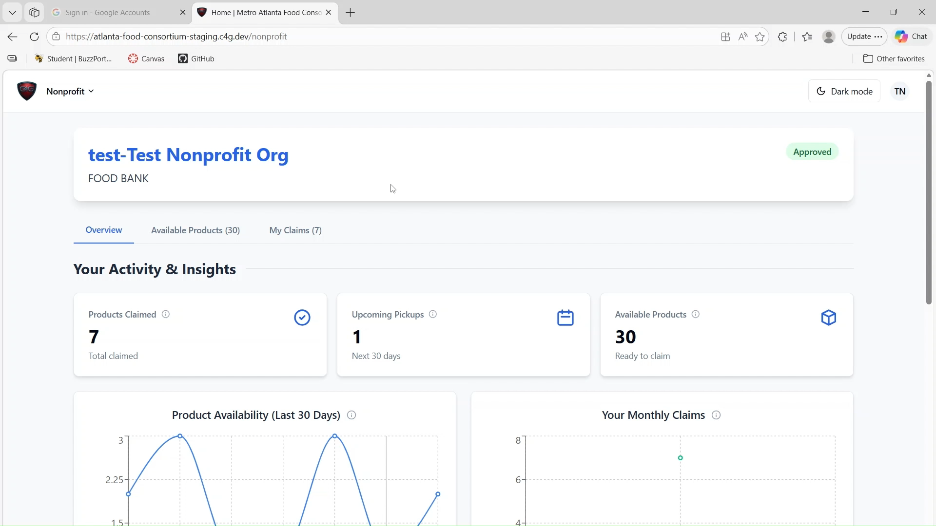
Demo Video – Nonprofit Role

Slide 5
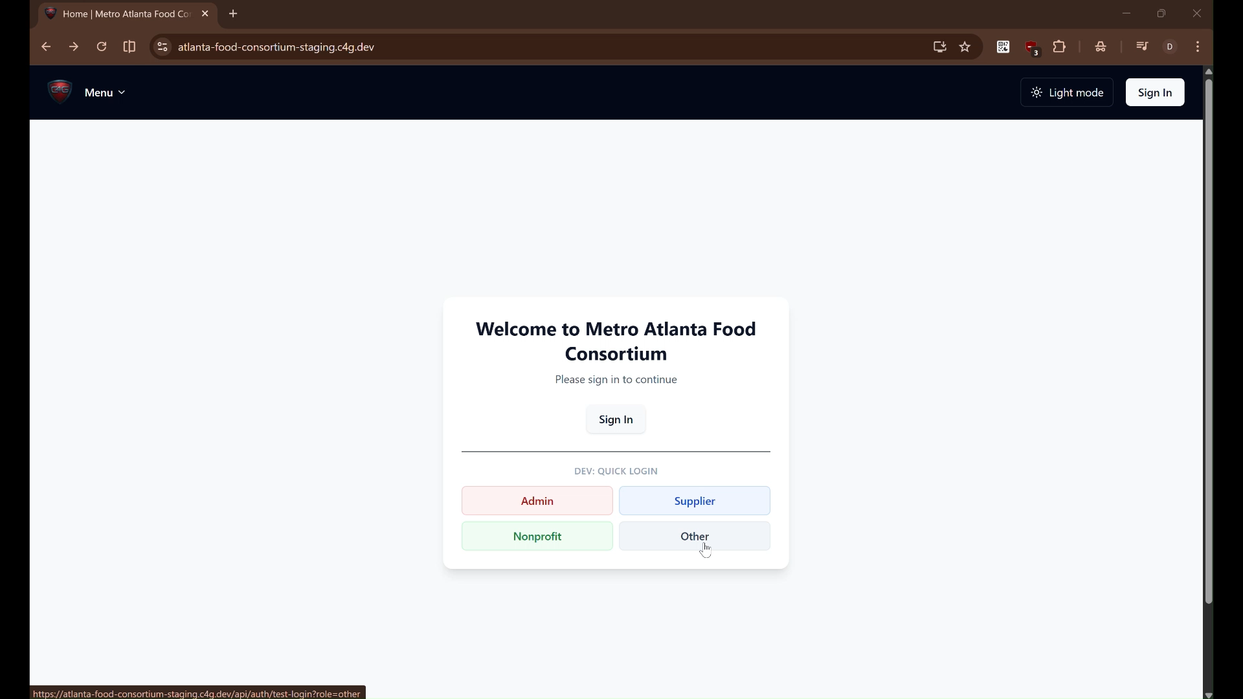
Demo Video – Other Role

Slide 6

Partner Engagement
Initial Partner Meeting
  Enid shared dashboard impressions and priorities – top suppliers, nonprofit claims, product types, and equity distribution
Stakeholder Survey
  We asked Enid to complete 2 tasks: change a user role to admin & identify top food categories
Feedback
  Overall impressed with the project and dashboard quality
  Wants visibility into nonprofit claim equity – flagging orgs claiming too frequently
  Most valued: product type distribution, Top nonprofits by claims, Top suppliers

Slide 7
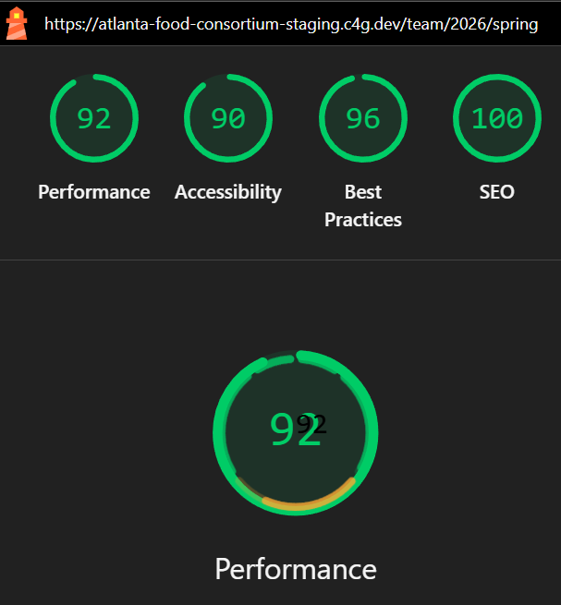
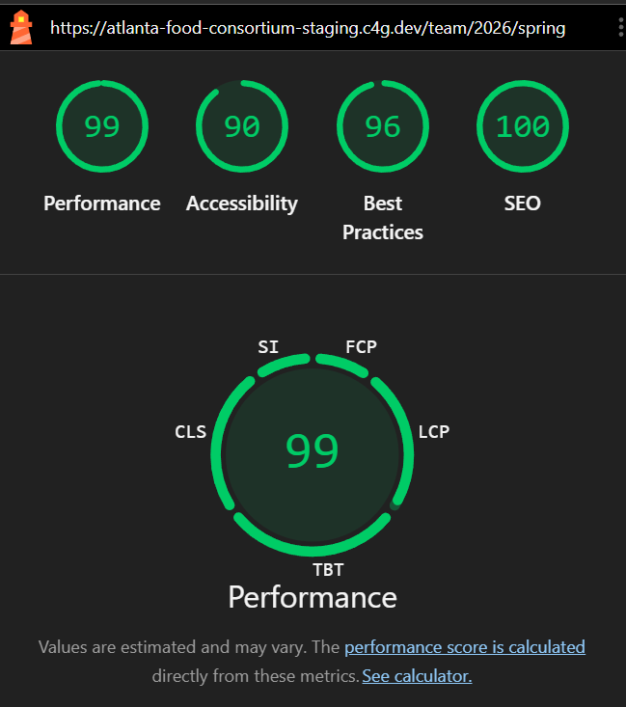

Project Lighthouse Scores
Mobile Lighthouse
92, 90, 96, 100
Desktop Lighthouse
99, 90, 96, 100

